Slide 1
ONLINE MOVIE TICKETS BOOKING

Slide 2
TEAM MEMBERS
EMPLOYEE ID | NAME | ROLE
2563935 | Kabilan M | Login module(Frontend and Backend)
2564331 | Kathiresan X | Filter module(Frontend and Backend)
2563523 | Niroop S Rao | Movie module(Frontend and Backend)
2564281 | Rishabh Chaurasia | Register module(Frontend and Backend)
2564006 | Shreya Ajit Kudachi | Payment module(Frontend )& Summary & JUNIT testing
2563893 | Sourav Kumar | Register/Login module(Frontend and Backend), Overall integration(Frontend and Backend)& Postman testing
2563060 | Vaishnavi Arunachalam | Cart module(Frontend and Backend)
2563534 | Wellwin K M | Admin module - Manage users and payment - (Frontend and Backend)

Slide 3
INTRODUCTION
The project “Online Movie Ticket Booking System” is dedicated to the general requirements of multiplex theaters.
The main aim of the project is to create an Online Movie Ticket Booking processing that allows customers to know more about the Movie details and functioning that gives the real life understanding of online movie ticket booking system

Slide 4
OBJECTIVE
The main objectives of our project are as follows:
Facility to store the information of new customer & different types of movie show timing & ticket rates of different types on show class etc.
Interest to develop a good user friendly website with many online transactions using a database.
To fulfill basic requirements and use of ease to book online movie, through online movie booking system.
To increase our knowledge horizon in technologies like spring boot, angular,postman etc.
To reduce the money and efforts in managing the record and saving time.

Slide 5
TOOLS AND TECHNOLOGIES
Front End: Angular 13
Server-Side: Spring Boot Data JPA
Backend: MySQL , Hibernate
Server: Tomcat
Operating System: Windows 10/11

Slide 6
ADMIN & USER ROLES
ADMIN ROLE | USER ROLE
Login Process (Sign In) Add/Delete Movies View and Update Movie Details Enable or Disable Movie Shows Manage Users Manage Purchases | Registration Process (Sign Up) Login Process (Sign In) Filter & Search based on end user needs Booking Process Payment & Summary Process

Slide 7
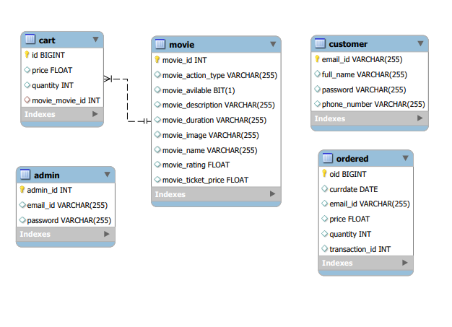
DATABASE SCHEMA

Slide 8
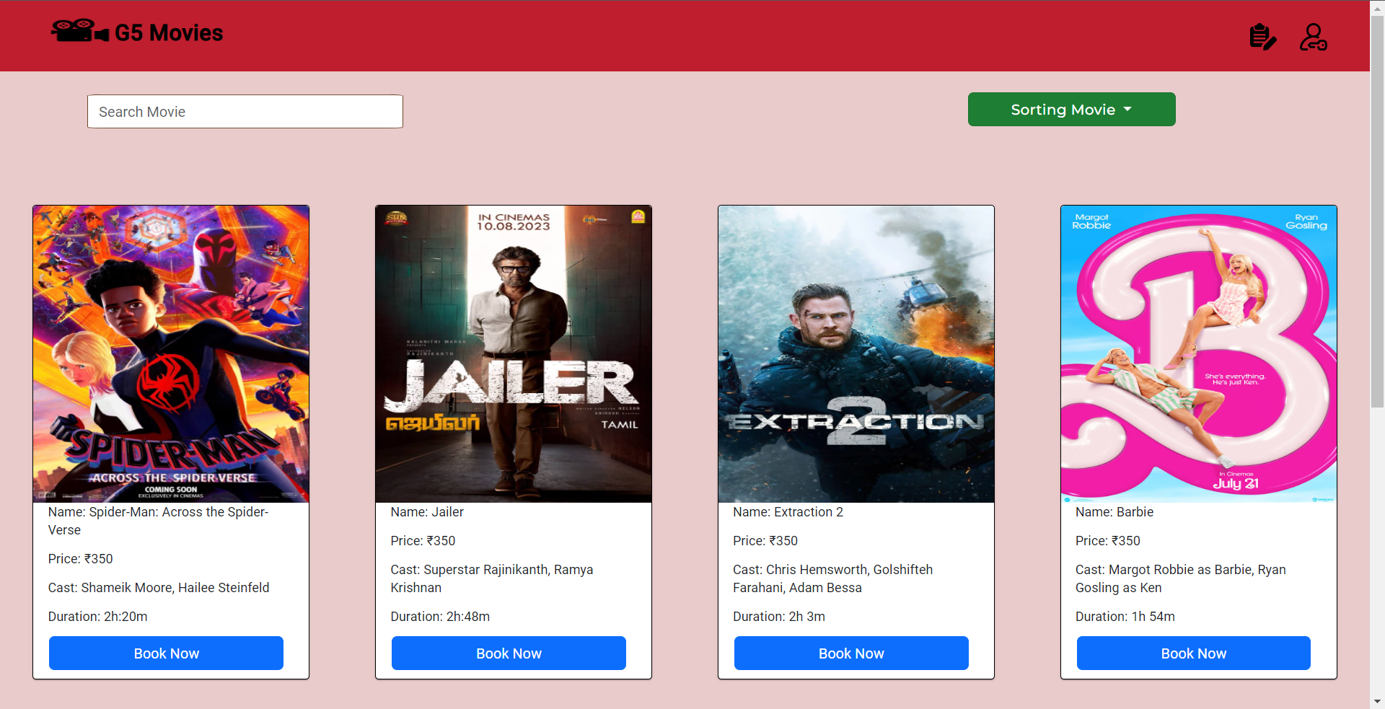
USER DASHBOARD

Slide 9
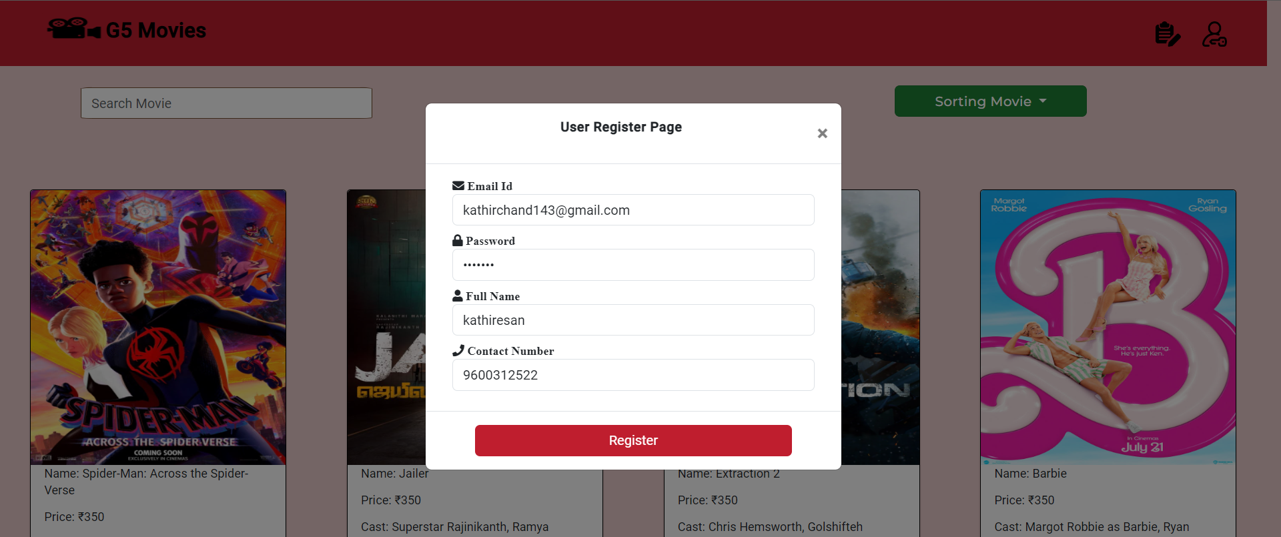
REGISTER USER

Slide 10
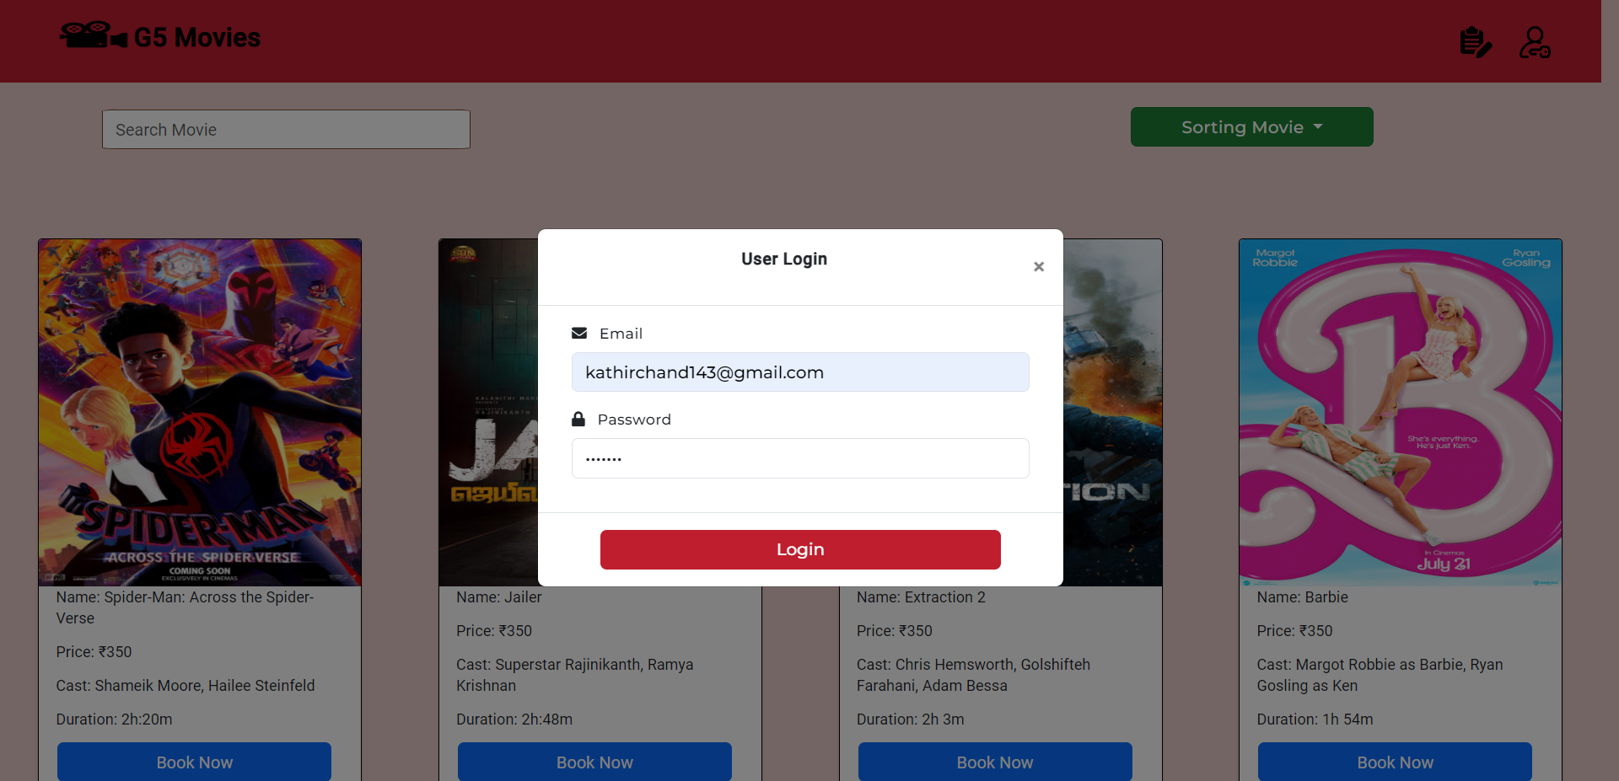
USER LOGIN

Slide 11
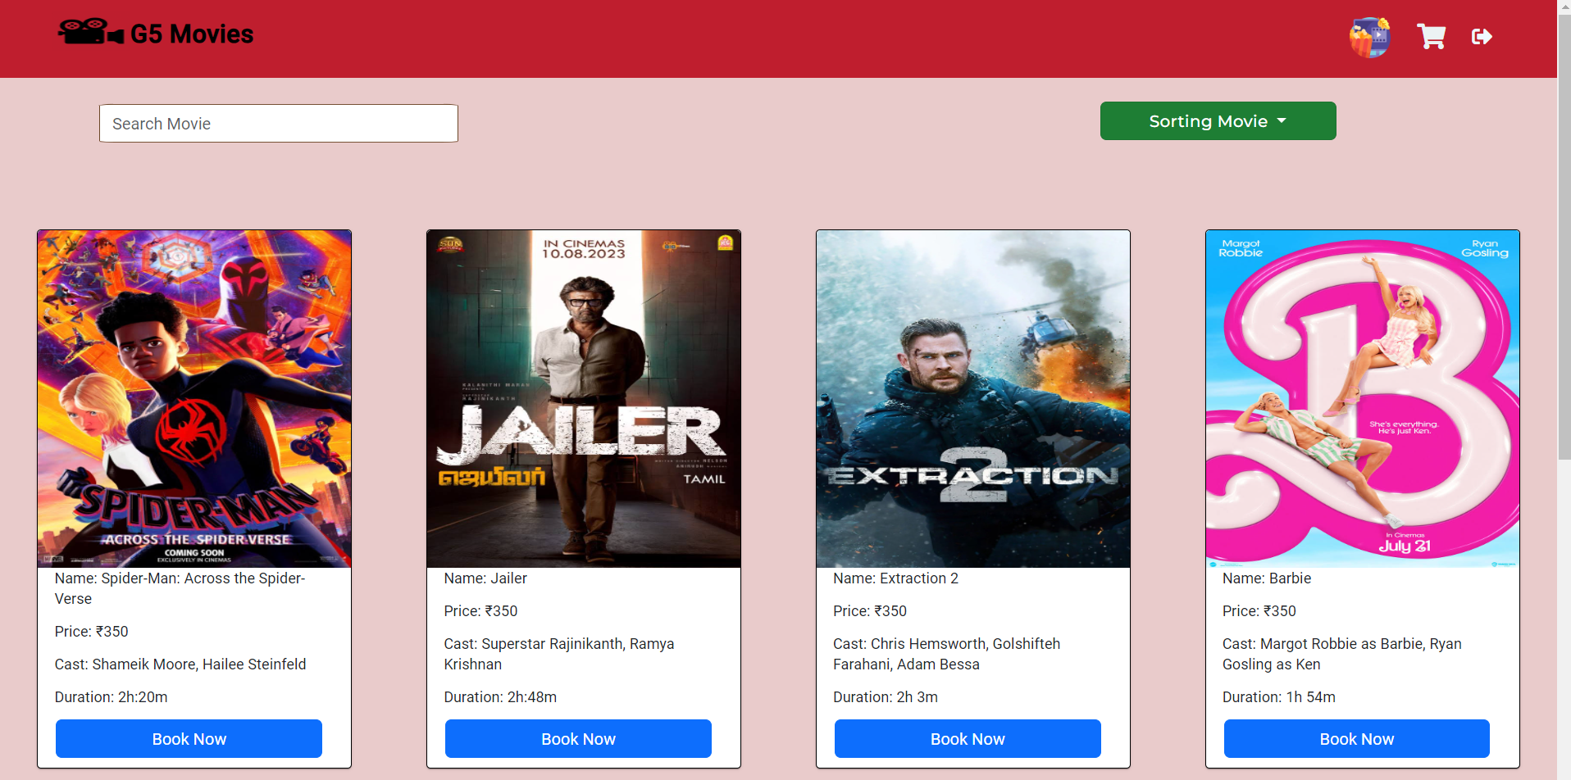
USER DASHBOARD
(AFTER LOGIN)

Slide 12
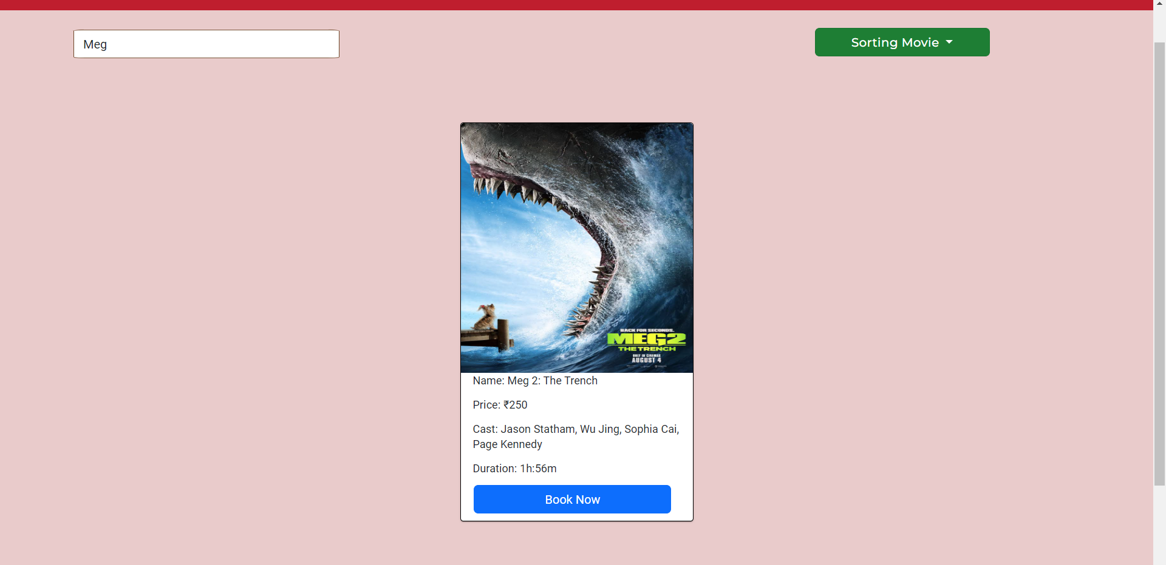
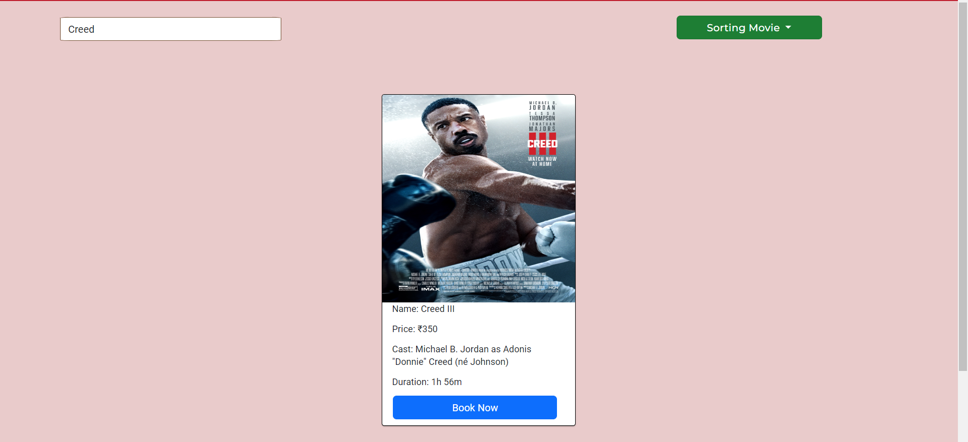
SEARCH MOVIE

Slide 13
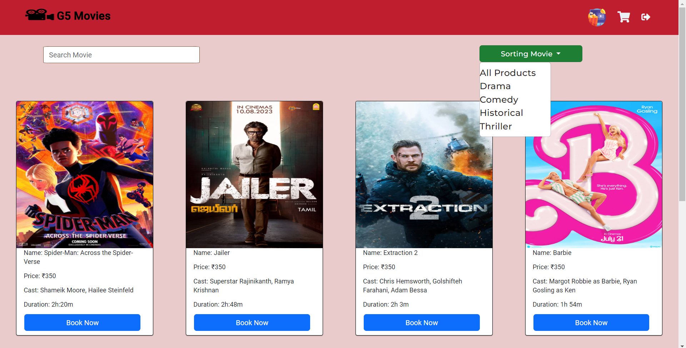
FILTER MOVIE

Slide 14
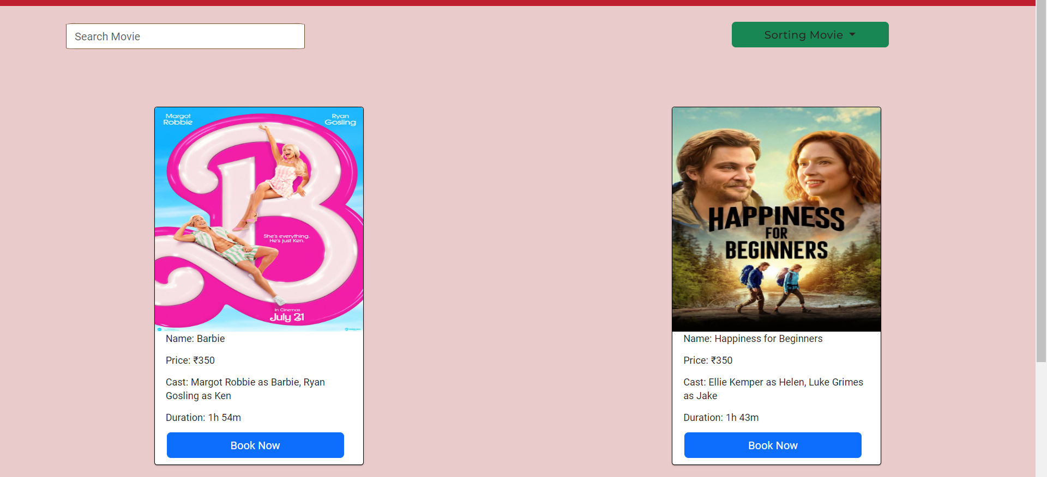
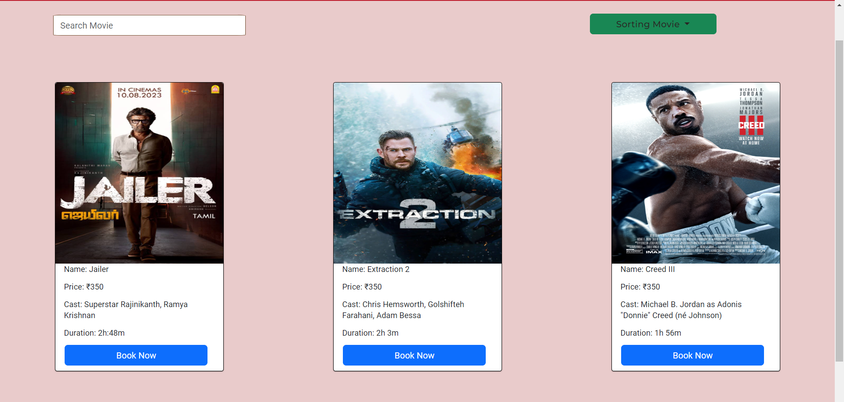
FILTERING
Comedy
Thriller

Slide 15
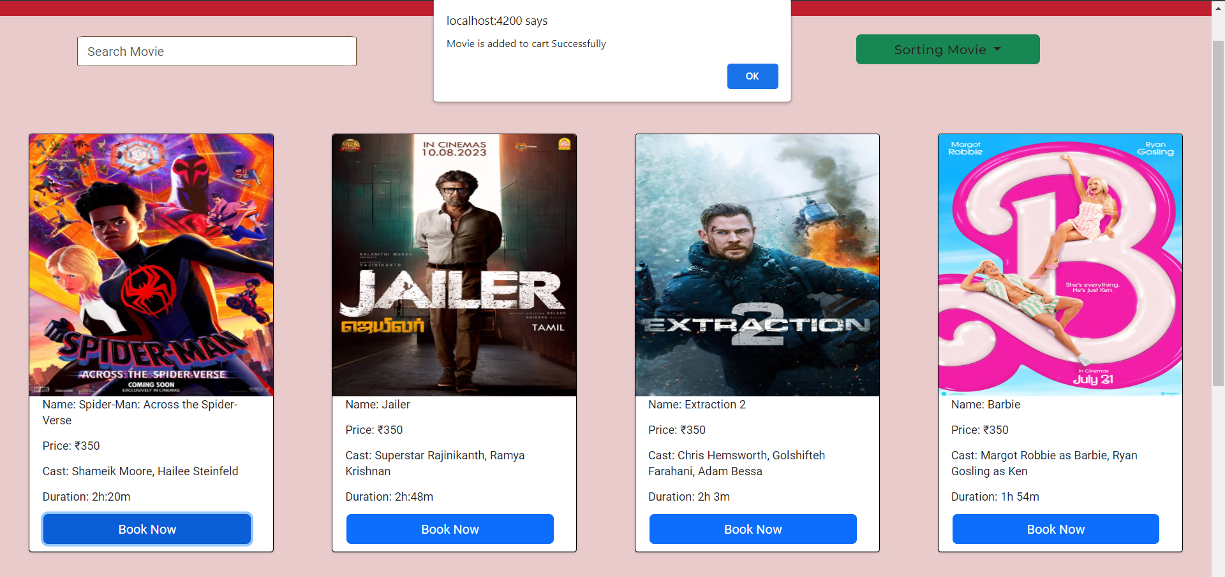
BOOK MOVIE

Slide 16
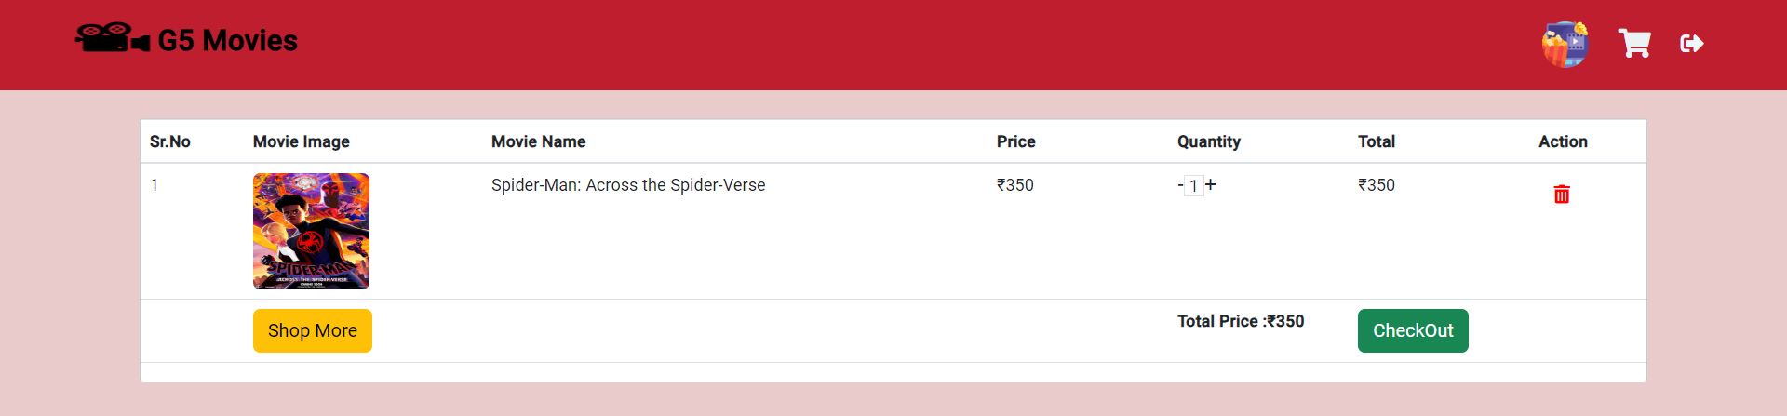
CART

Slide 17
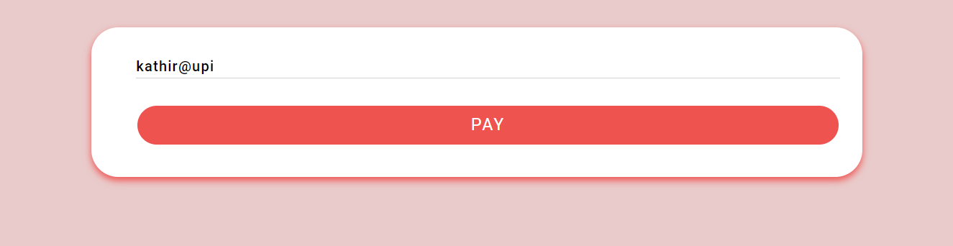
PAYMENT

Slide 18
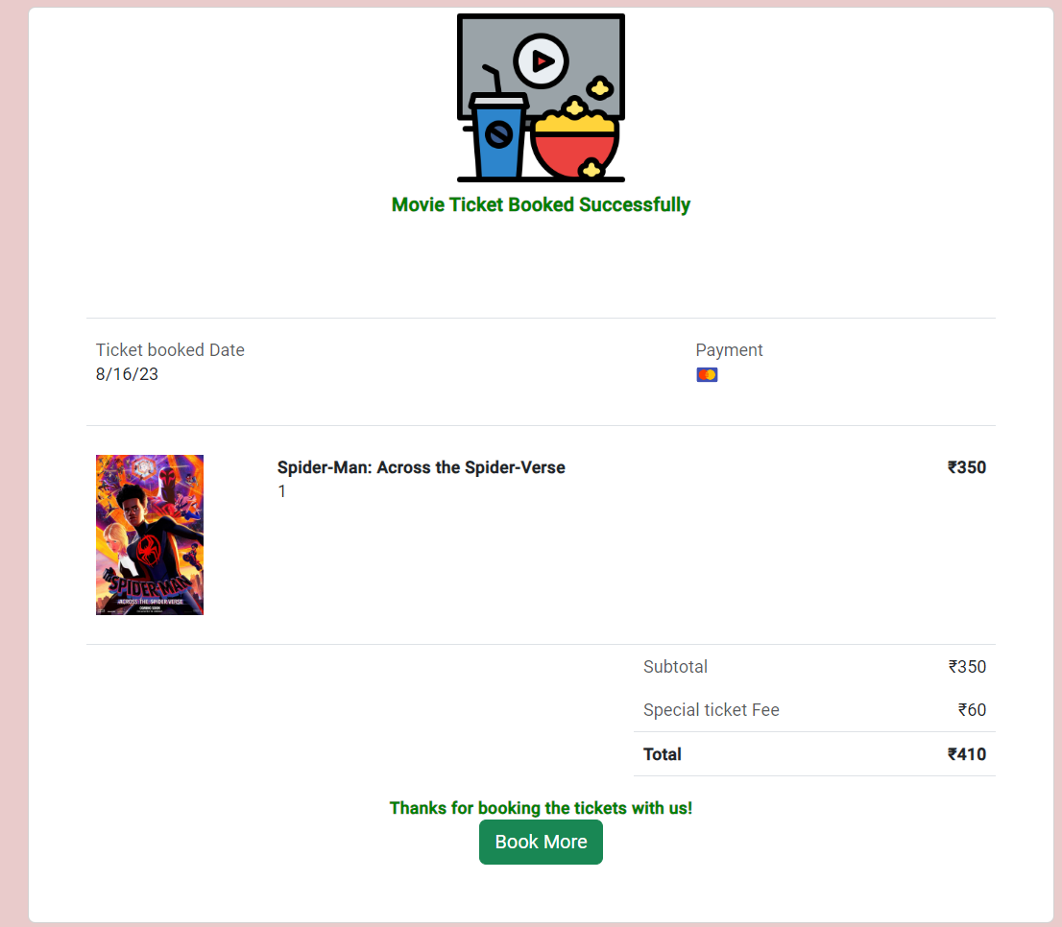
ORDER SUMMARY

Slide 19
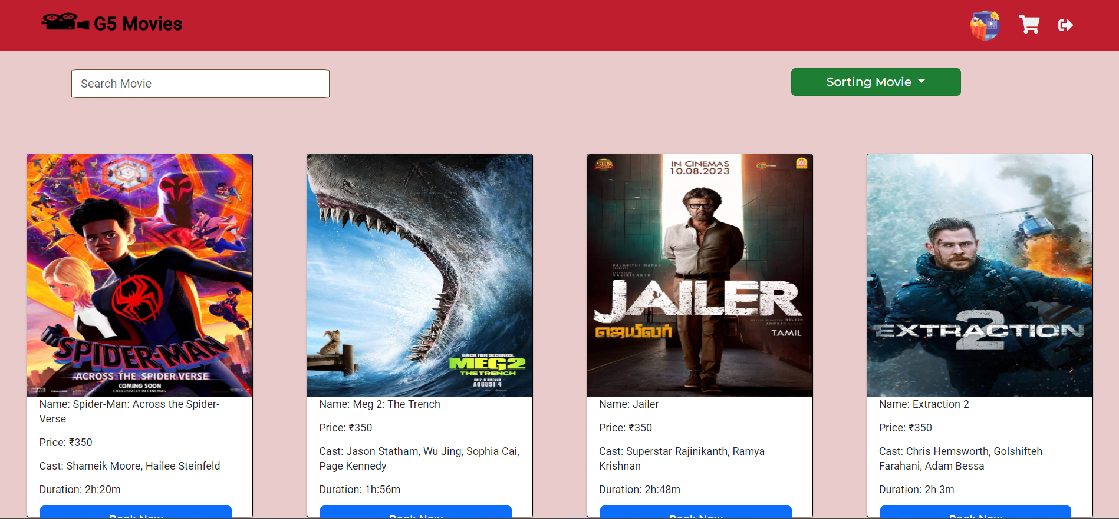
USER DASHBOARD (AFTER CLICKING ON BOOK MORE)

Slide 20
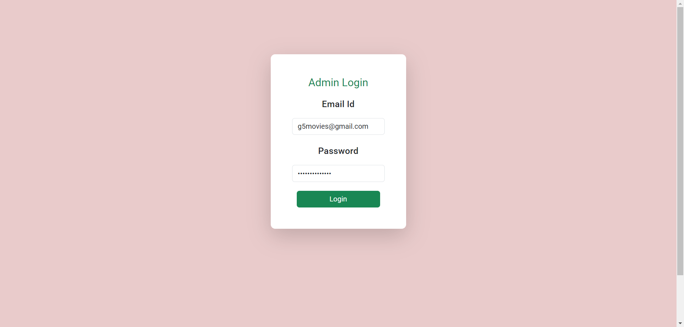
ADMIN LOGIN

Slide 21
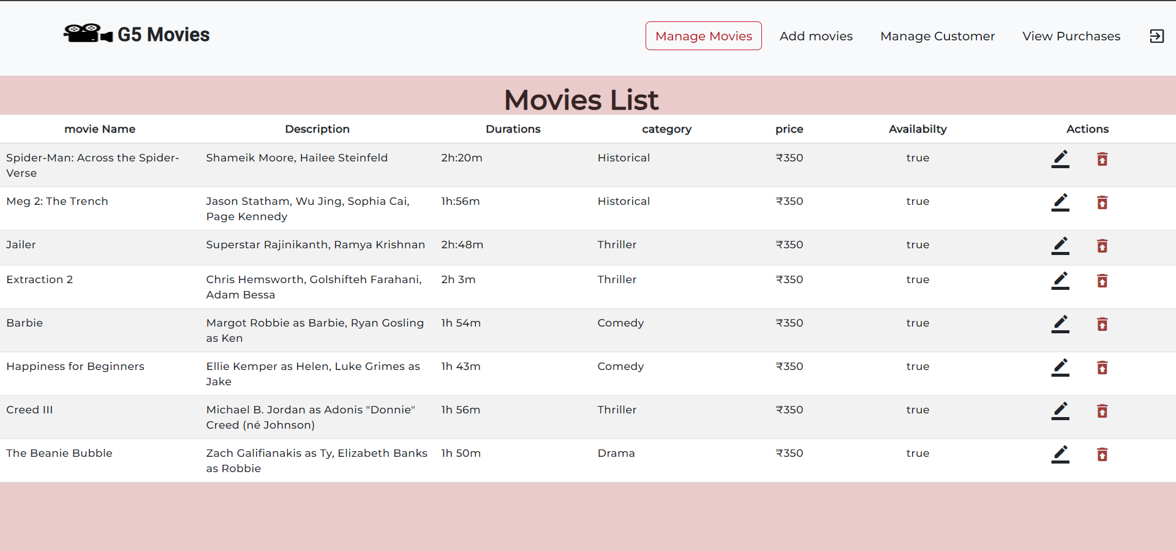
ADMIN DASHBOARD

Slide 22
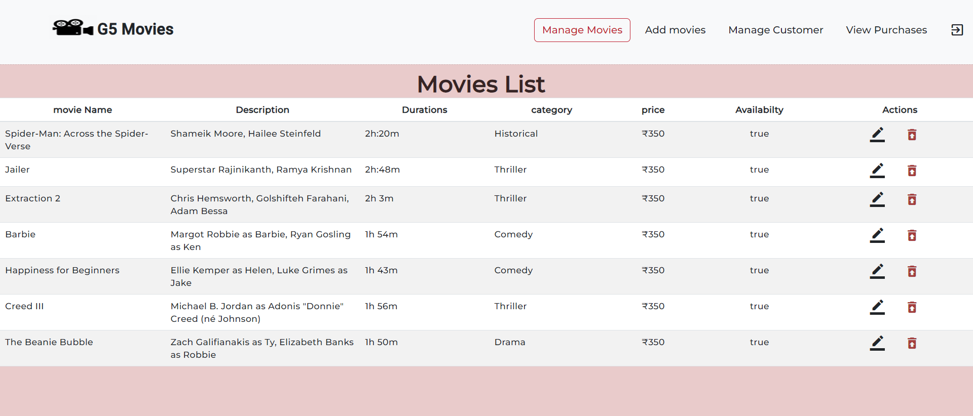
DELETED MOVIE

Slide 23
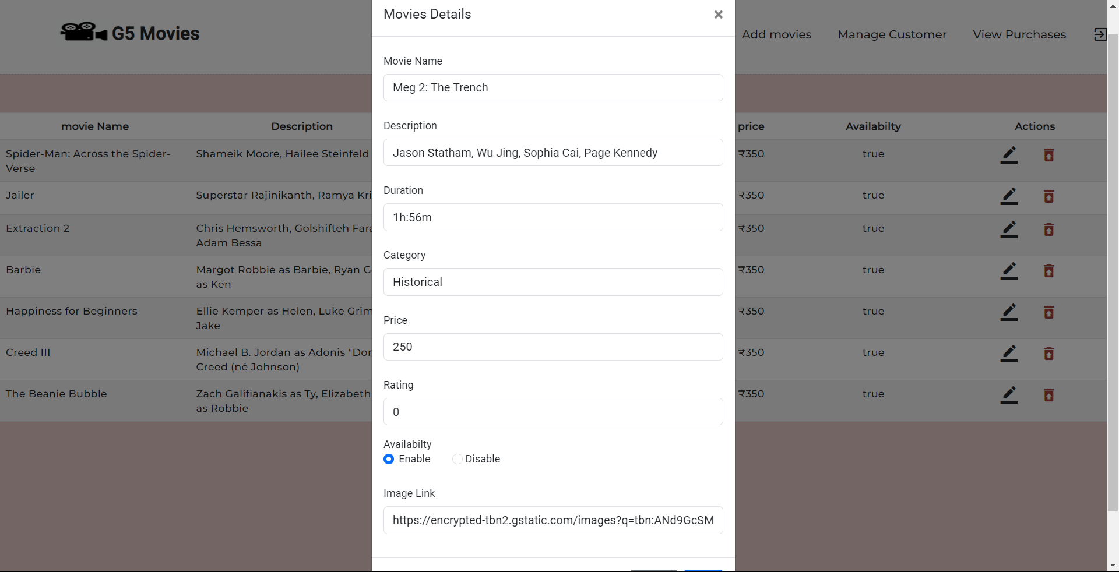
ADDING MOVIE

Slide 24
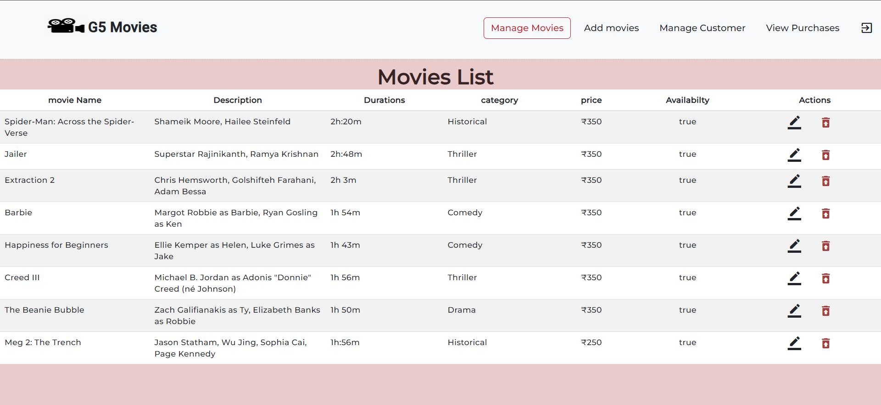
AFTER ADDING MOVIE

Slide 25
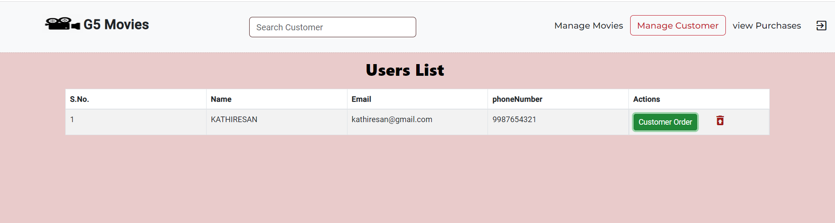
MANAGE CUSTOMER

Slide 26
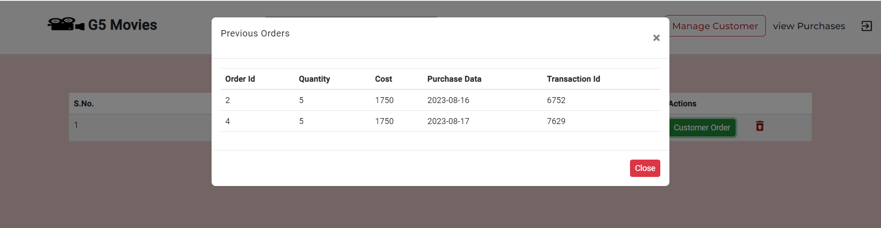
MANAGE CUSTOMER
(AFTER CLICKING CUSTOMER ORDER)

Slide 27
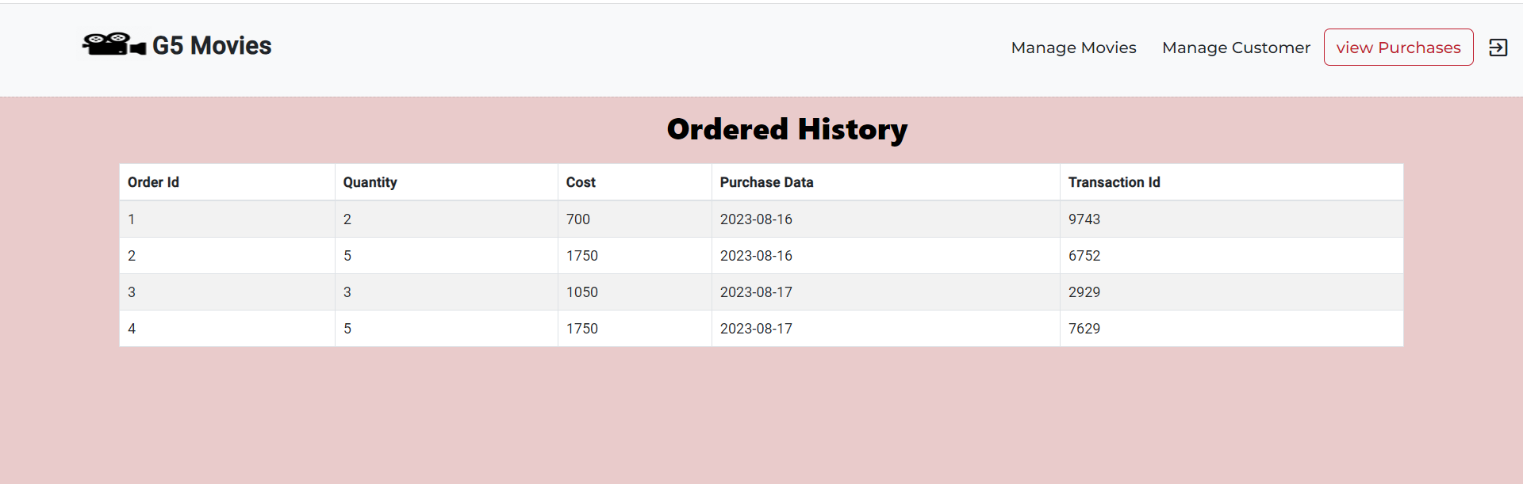
ORDER HISTORY

Slide 28
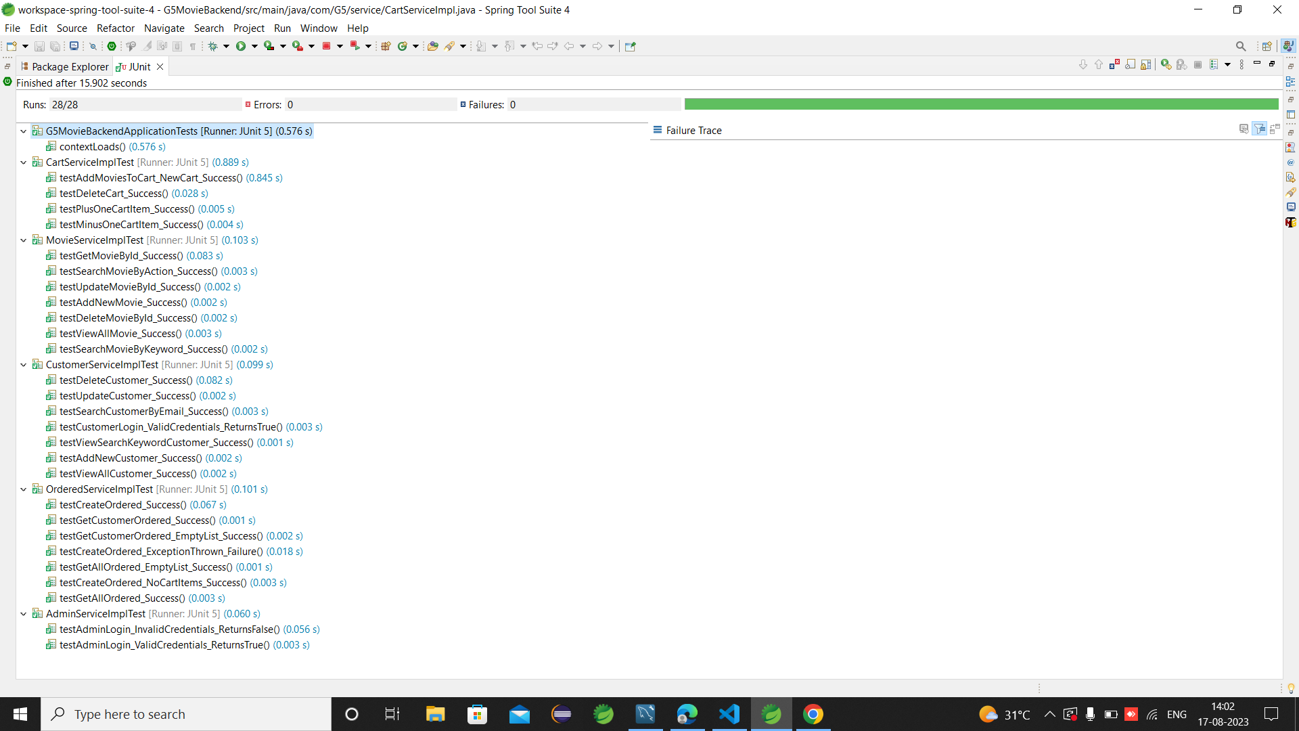
JUNIT TESTING

Slide 29
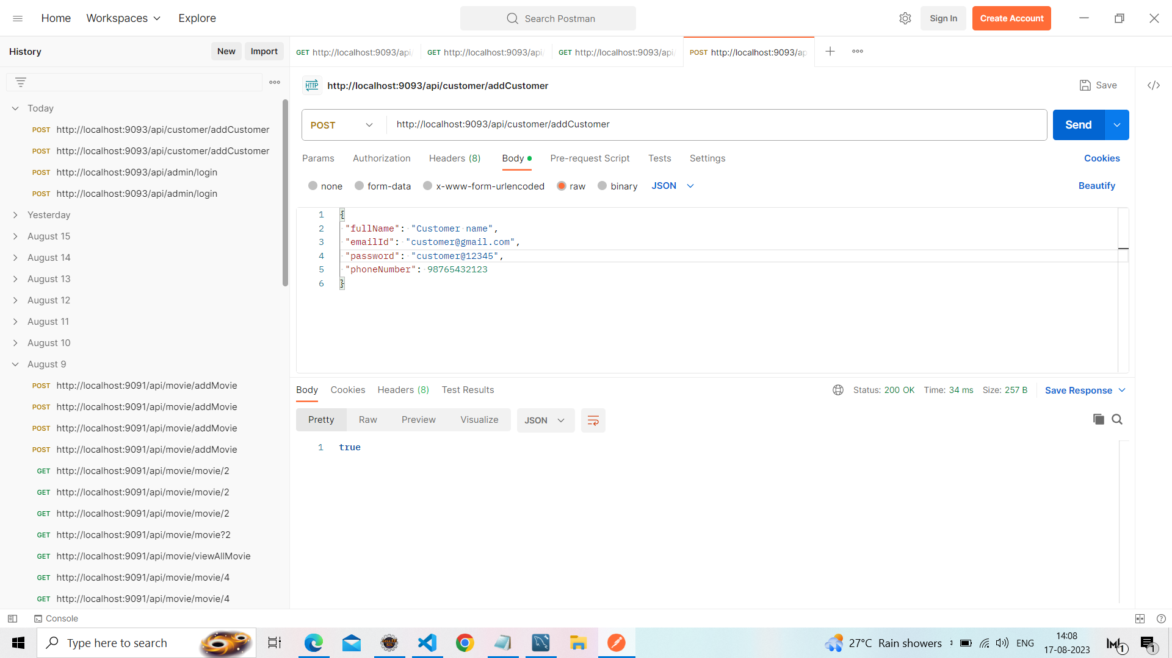
POSTMAN TESTING

Slide 30
CONCLUSION
This project has been developed successfully and the overall performance of the system has been found satisfactory.
We have successfully created the user friendly interface for both the admin and the end user with basic functionalities.

Slide 31
THANK YOU

